Slide 1
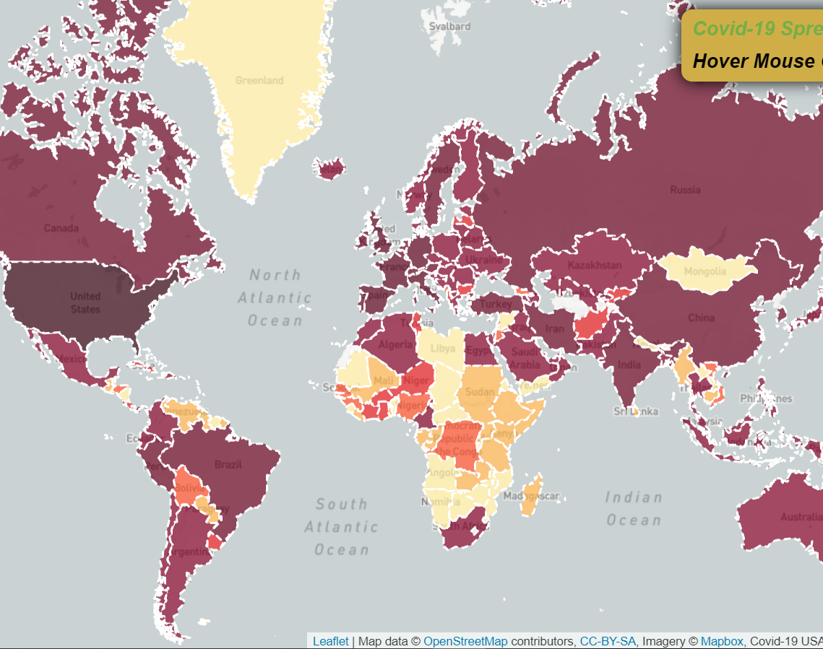
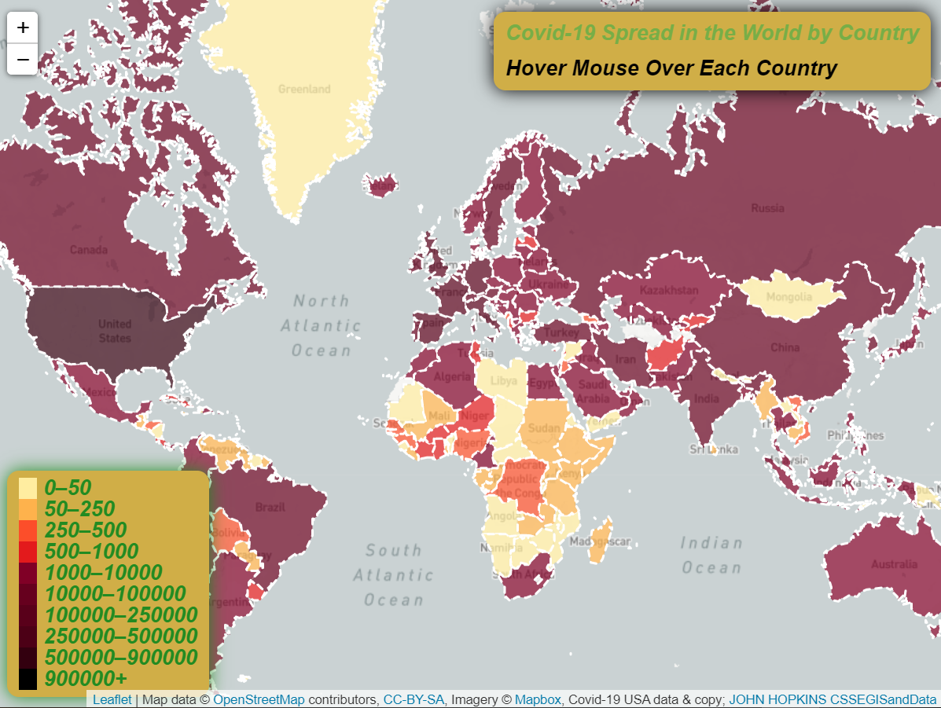
COVID-19 Spread Globally
This presentation is meant to showcase my skills level acquired in the Web Mapping class.
PROJECT GOAL
Create a colorful interactive choropleth map of the global spread of Covid-19 using GeoJSON and some custom controls and styles.

Slide 2
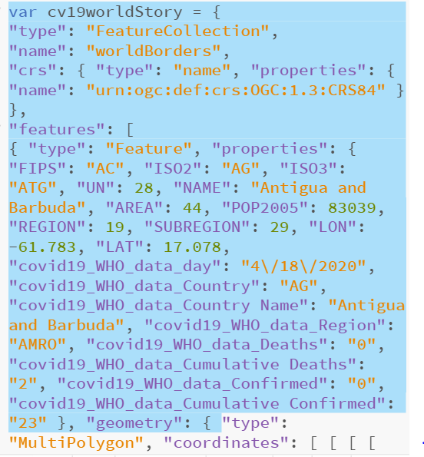
Data Source
Looking at Covid-19 case breakdown by country:
Countries are represented by geographic borders.
Covid-19 cases are broken-down into:
Confirmed Cases
Death per country and
Last time data was updated
Data is presented in a GeoJSON (JavaScript Object Notation) file ( an open standard format designed for representing simple geographical features, along with their non-spatial attributes)
Data: JOHN HOPKINS CSSEGISandData/COVID-19
https://avatars2.githubusercontent.com/u/60674295?s=400&u=cda3e09cda856b17dbc71dbd50b87f75955e7e48&v=4

Slide 3
Visual Hierarchy
Display countries geographic boundary data on a map with a custom Mapbox style DARK greyscale tiles
Parse GeoJSON data in leaflet and display it on the map
Color the countries according to the total number of confirmed Covid-19 cases:
Color values from ColorBrewer (using sequential color class) and then
Creates a function that returns each color based on the total number of confirmed cases in the respective country
Styling function to visualize geospatial features of the GeoJSON file
Set fill color to JSON attribute (confirmed cases in a country)
Event Listeners for mouse hovering and clicks (access layer via e.target)
Create the handy geojson.resetstyle method to reset styles to defaults
Set click listeners: Zooms into the Country clicked
Set OnEachFeature Function: Functionality of the above functions depends on this one.

Slide 4
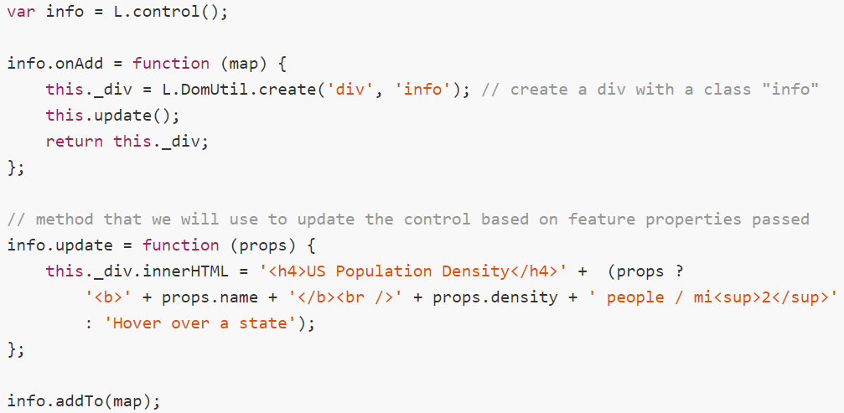
………. Visual Hierarchy
Set Custom Controls from where attributes data is displayed at map hover
` # Controls feature properties already passed
nn n # Creates a div with class info
Create and Control map legend
THANK YOU!!!

